Slide 1
Saliency Detection
in Remote Sensing Images
Group Members
Damini Sarma (232010001) : daminis23@iitk.ac.in
Shashwat Amit Parikh (241040080) : shashwatap24@iitk.ac.in
Rick Ghosh (208170783) : rickg20@iitk.ac.in

Slide 2
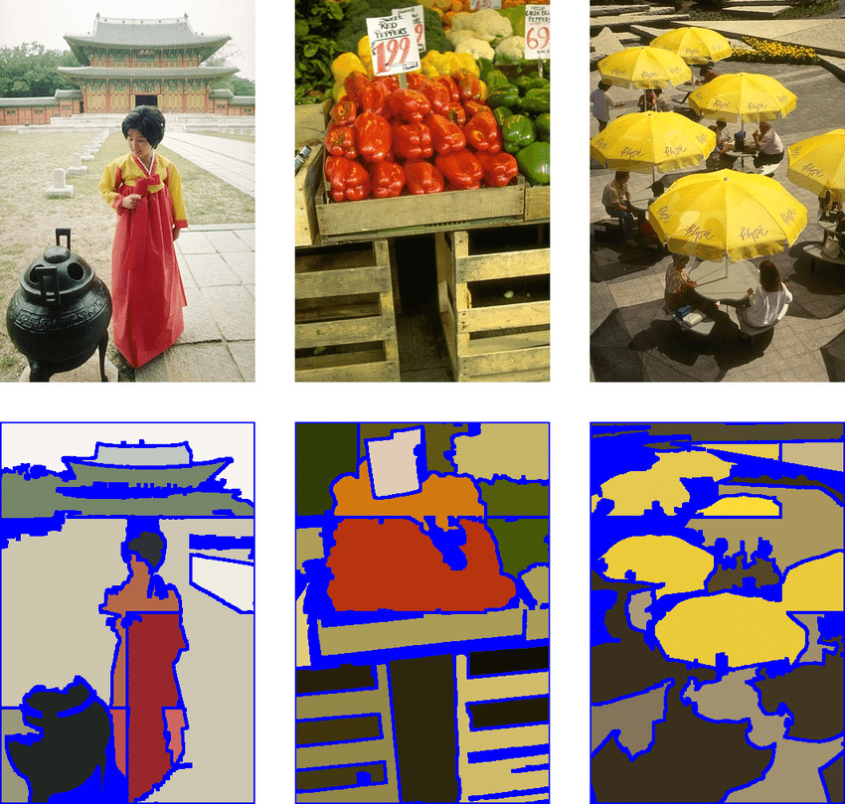
Problem Statement: Input and Output
Salient Regions and Saliency Detection:
Salient Region: Most attentive location or region on the basis of the human visual system.
This becomes foreground, rest of the image - background
Remote Sensing Images: Large amount of information, accurate interpretation, segmentation that mimics the way humans
perceive salient regions. Segmentation into homogenous regions based on – color, intensity, texture etc.

Slide 3
Literature Review: What has been done before?
For high resolution imagery, we need an algorithm which reduces computational complexity, processing time and enhances the quality of generated outputs
Method | Advantages | Limitations
SLIC (Simple Linear Iterative Clustering) | Segmentation of standard images, reduces complexity | Inconsistent shape, size of super-pixels in high resolution remote sensing images, error in segmentation
Mean Shift | Good Adherence to boundaries in segmentation | Computationally Intensive. Lesser efficiency for satellite images
Normalized Cuts | Very good adherence to boundaries, | Limited scalability for satellite images, higher computational demands
Felzenszwalb and Huttenlocher’s Method | Treats pixels as nodes within graphs, groups them, high boundary adherence | Super pixels with irregular shapes and sizes, lacks control over number of super pixels
Quick Shift | Based on density estimates of the features | Lacks flexibility in terms of the super pixel count and size

Slide 4
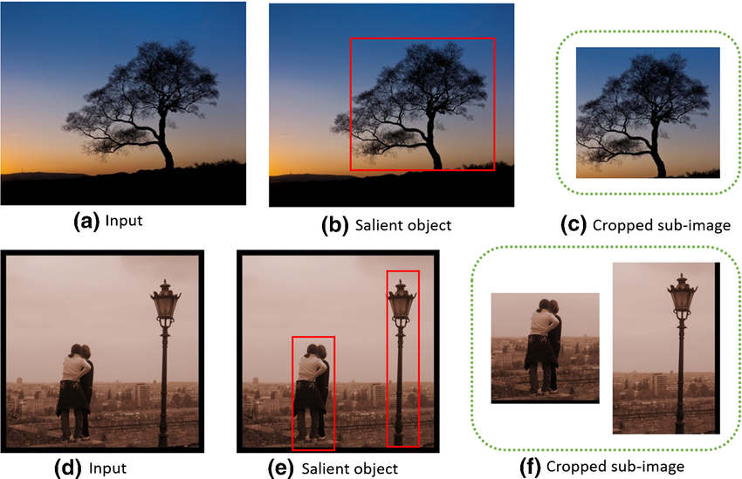
Literature Review: How is our work different?
Our Algorithm | How it overcomes the limitations of pre-existing algorithms
Traverse-based Adaptive Clustering for Saliency Detection | Combines efficient clustering and adaptive thresholding Works well for saliency detection of general images Works efficiently for saliency detection in remote sensing images Takes into account spatial distance and color characteristics of pixels Handles the heterogeneity and diversity of objects present in remote sensing images

Slide 5
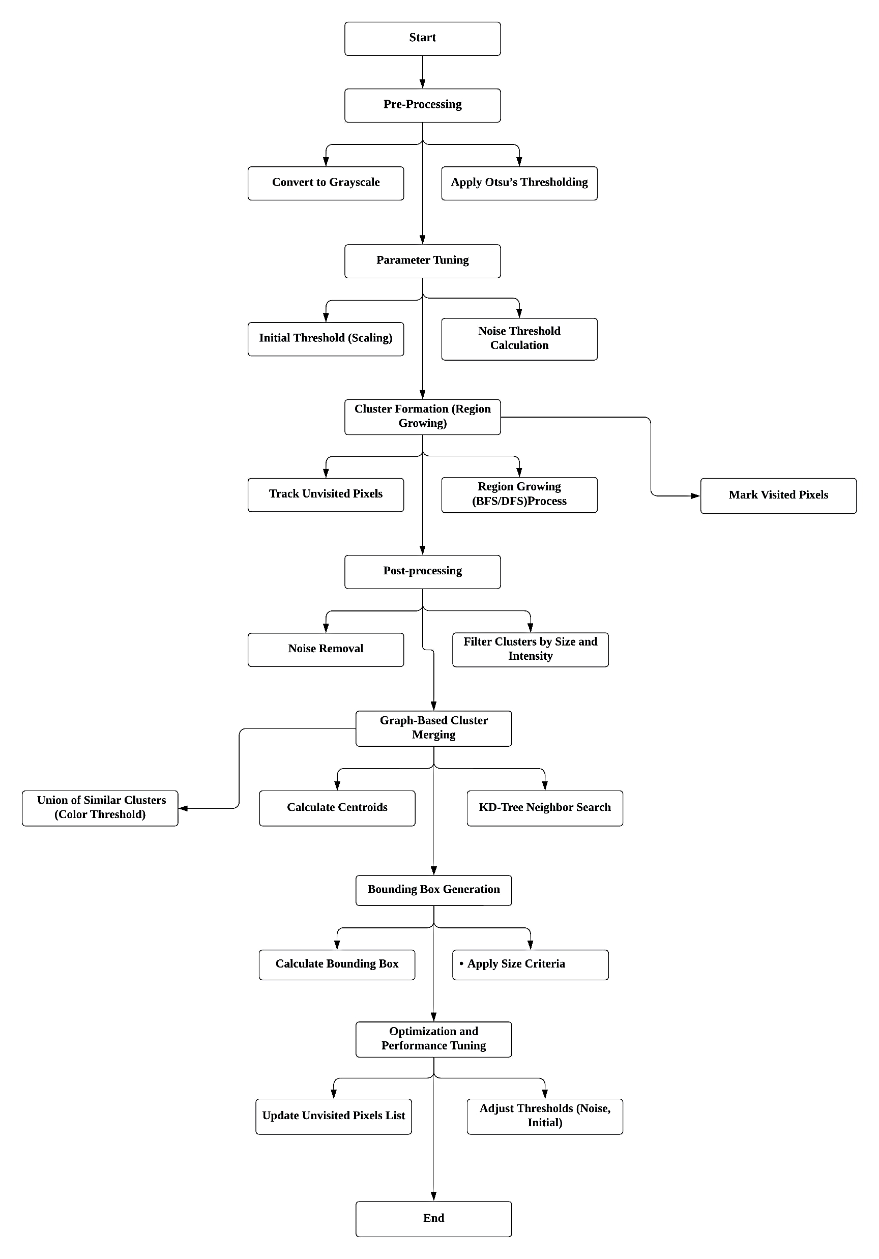
Proposed Method: Set of steps and why each step was chosen?
Traverse-based Adaptive Clustering for
Saliency Detection
10-11-2024 EE 604: Image Processing Course Project 5

Slide 6
Algorithm:
Initialize an empty cluster.
Start with a pixel and check in its 3x3 neighbourhood.
If the neighbouring pixels are similar to the current pixel and are unvisited then we add them to our cluster and mark them as visited.
Move in the direction of the nearest pixel value.
Repeat until we encounter a pixel value that has no unvisited neighbours or none of them satisfy our clustering conditions.
Save the cluster.
Search to the first unvisited pixel and repeat the process.
10-11-2024 EE 604: Image Processing Course Project 6

Slide 7
Algorithm:
Start with a pixel and traverse in the direction of similar pixels and group them until all neighbours are visited.
10-11-2024 EE 604: Image Processing Course Project 7

Slide 8
Problem?
Might end up creating more clusters than required.
10-11-2024 EE 604: Image Processing Course Project 8

Slide 9
BFS
Instead of moving in direction of the nearest pixel value, we assign priority. [left, right, up, down]
We achieve this by using BFS.
10-11-2024 EE 604: Image Processing Course Project 9

Slide 10
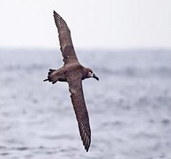
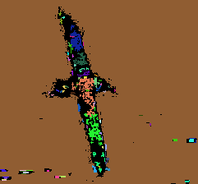
Noisy clusters
We remove the noisy clusters based on the cluster size.
If there are very few pixels in a cluster then it is likely to be something not of our interest.
10-11-2024 EE 604: Image Processing Course Project 10

Slide 11
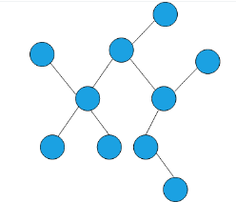
Merging
Now, as we can see, the results may not always be perfect and we might need to merge certain clusters.
We compute the cluster centroids.
Then we use kd trees to find the neighbouring clusters and create a graph.
Every edge represents a neighbour.
Then we merge clusters based on colour difference. This threshold is generally kept easier than the initial threshold.
10-11-2024 EE 604: Image Processing Course Project 11

Slide 12

Experiments : Datasets Used, Implementation and Some Results
Initial_threshold: 10
Noise_threshold: 1
Radius: 30
Color_diff_threshold: 20
10-11-2024 EE 604: Image Processing Course Project 12

Slide 13

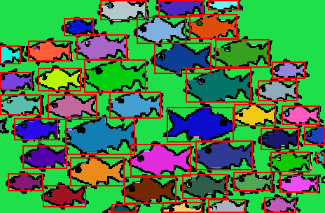
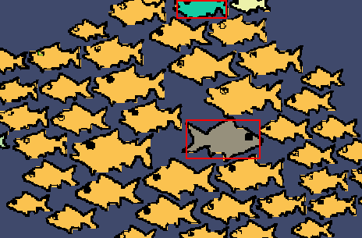
Experiments : Datasets Used, Implementation and Some Results
Initial_threshold: 5
Noise_threshold: 5
Radius: 10
Color_diff_threshold: 10
Initial_threshold: 5
Noise_threshold: 5
Radius: 50
Color_diff_threshold: 20
10-11-2024 EE 604: Image Processing Course Project 13

Slide 14

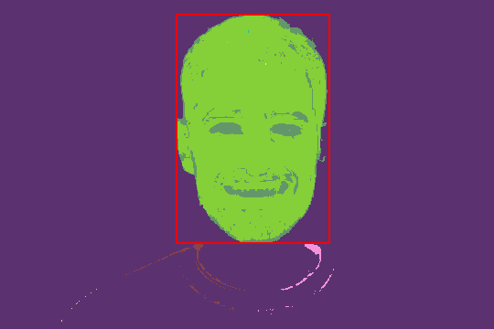
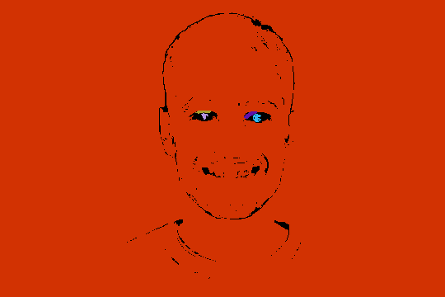

Experiments : Datasets Used, Implementation and Some Results
10-11-2024 EE 604: Image Processing Course Project 14

Slide 15


Experiments : Datasets Used, Implementation and Some Results
10-11-2024 EE 604: Image Processing Course Project 15

Slide 16
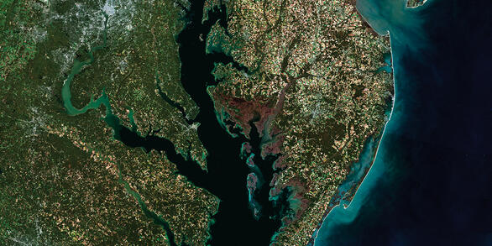
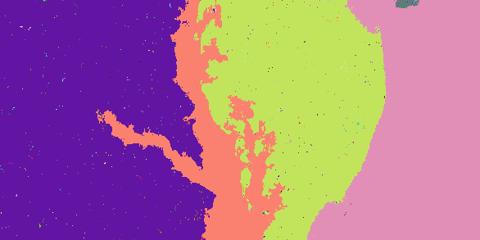
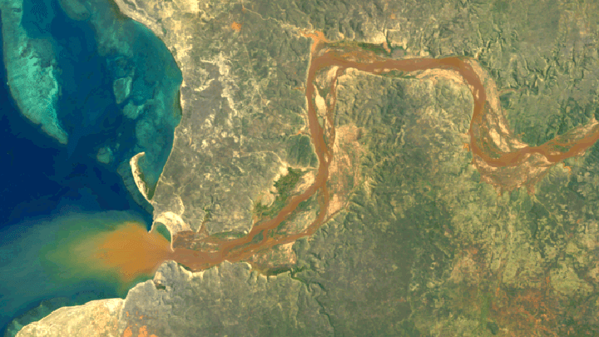
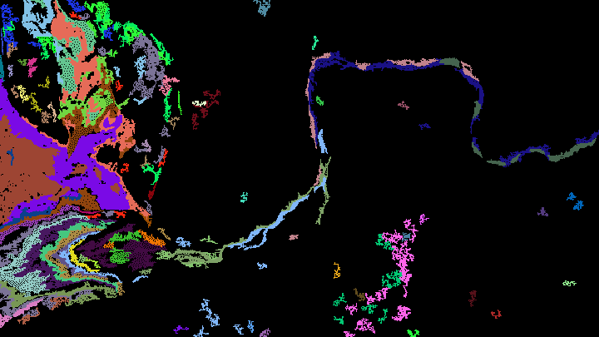
Experiments : Datasets Used, Implementation and Some Results
10-11-2024 EE 604: Image Processing Course Project 16

Slide 17
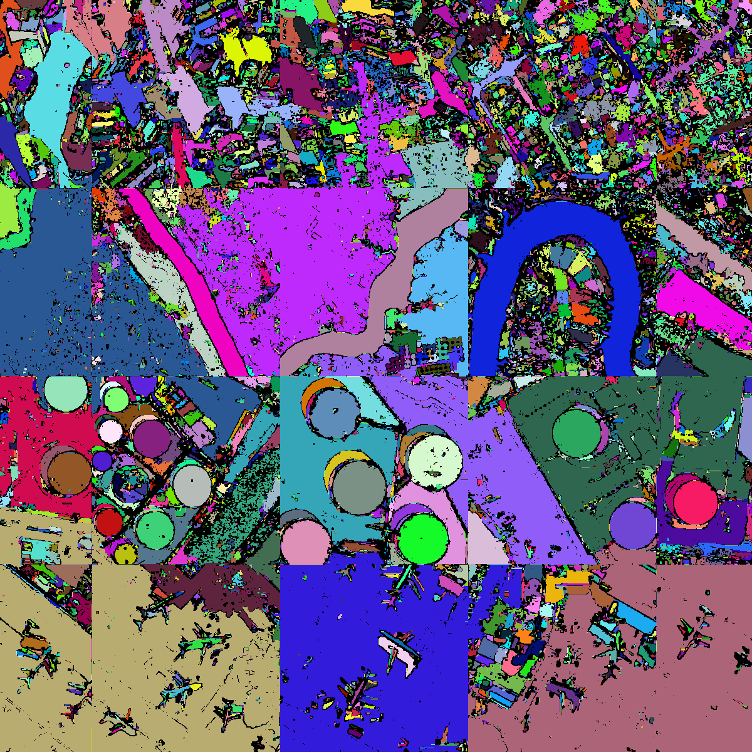
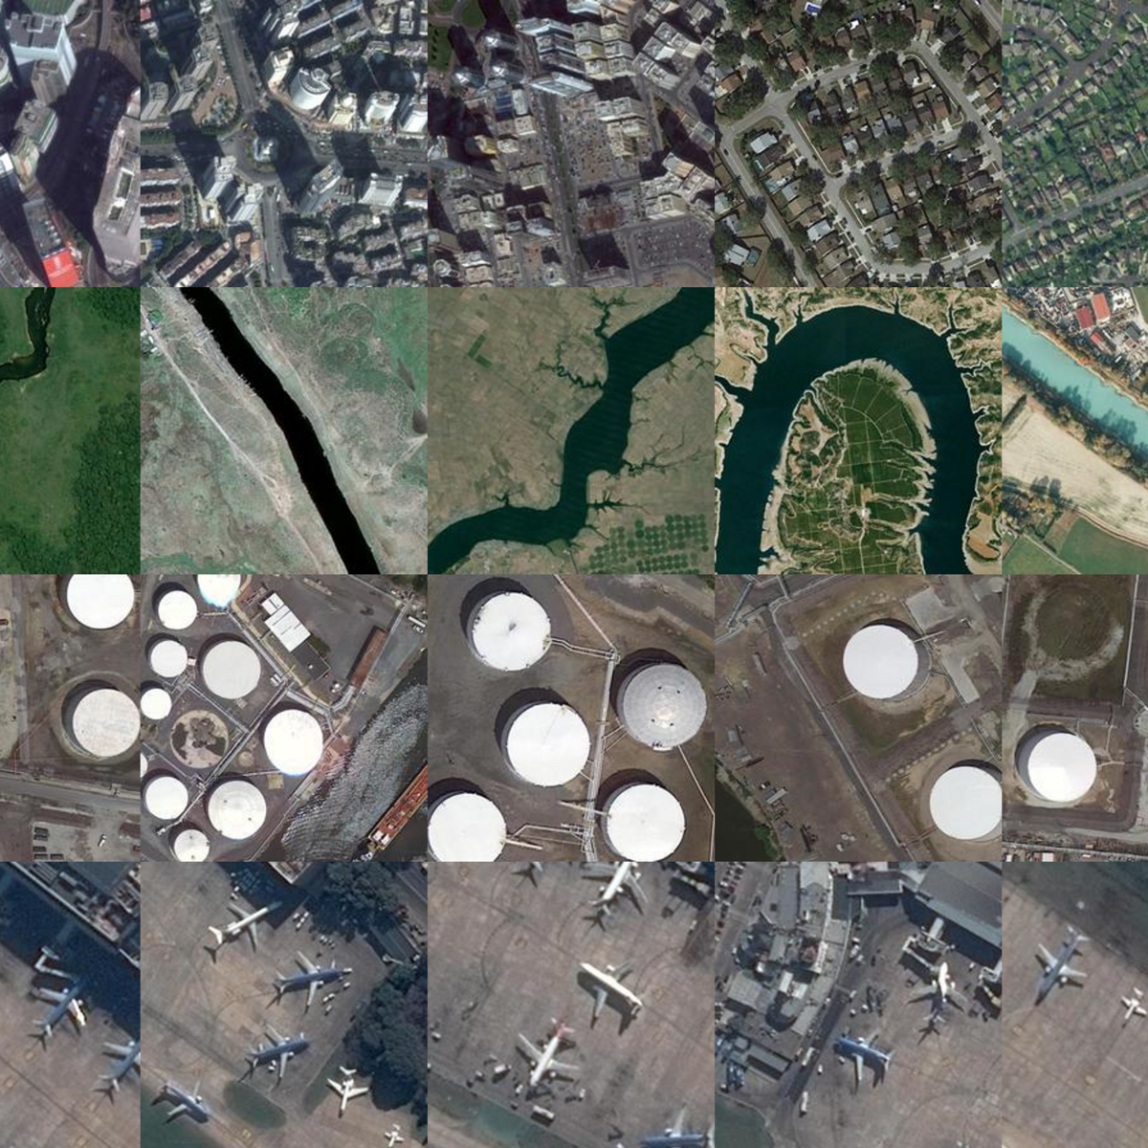
Experiments : Datasets Used, Implementation and Some Results
10-11-2024 EE 604: Image Processing Course Project 17

Slide 18
Advantages of our algorithm
Multiple parameters to tweak with.
Quick Solution, O(N).
Optimum segments.
Different size segments.
Very versatile.
Lesser postprocessing

Slide 19
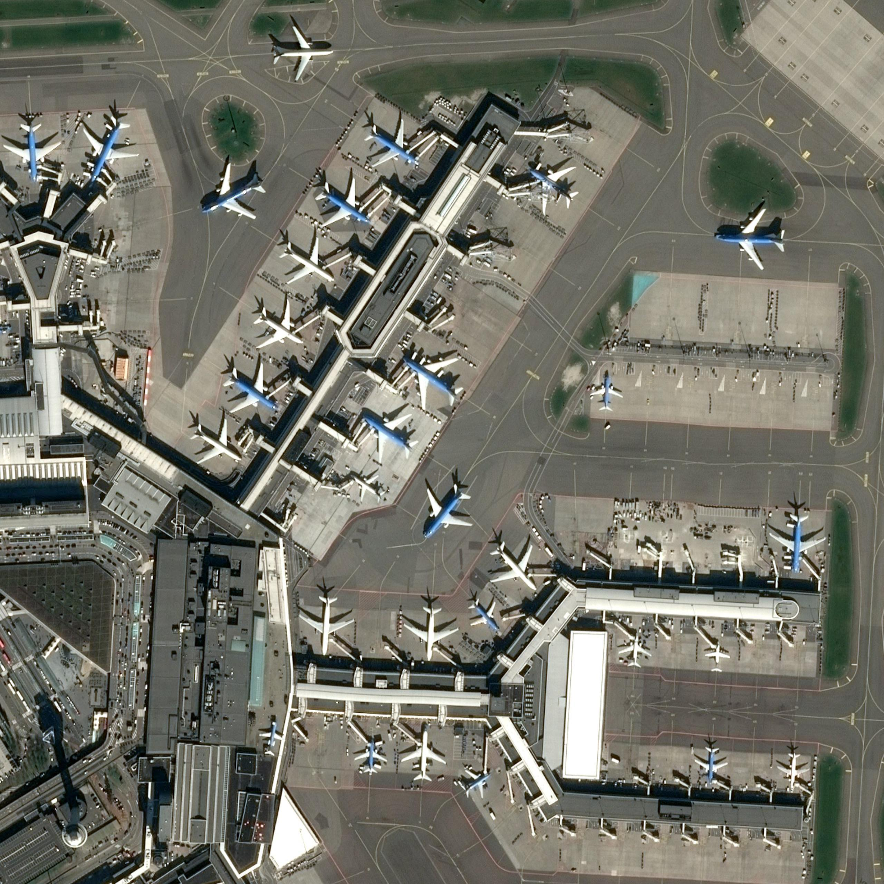
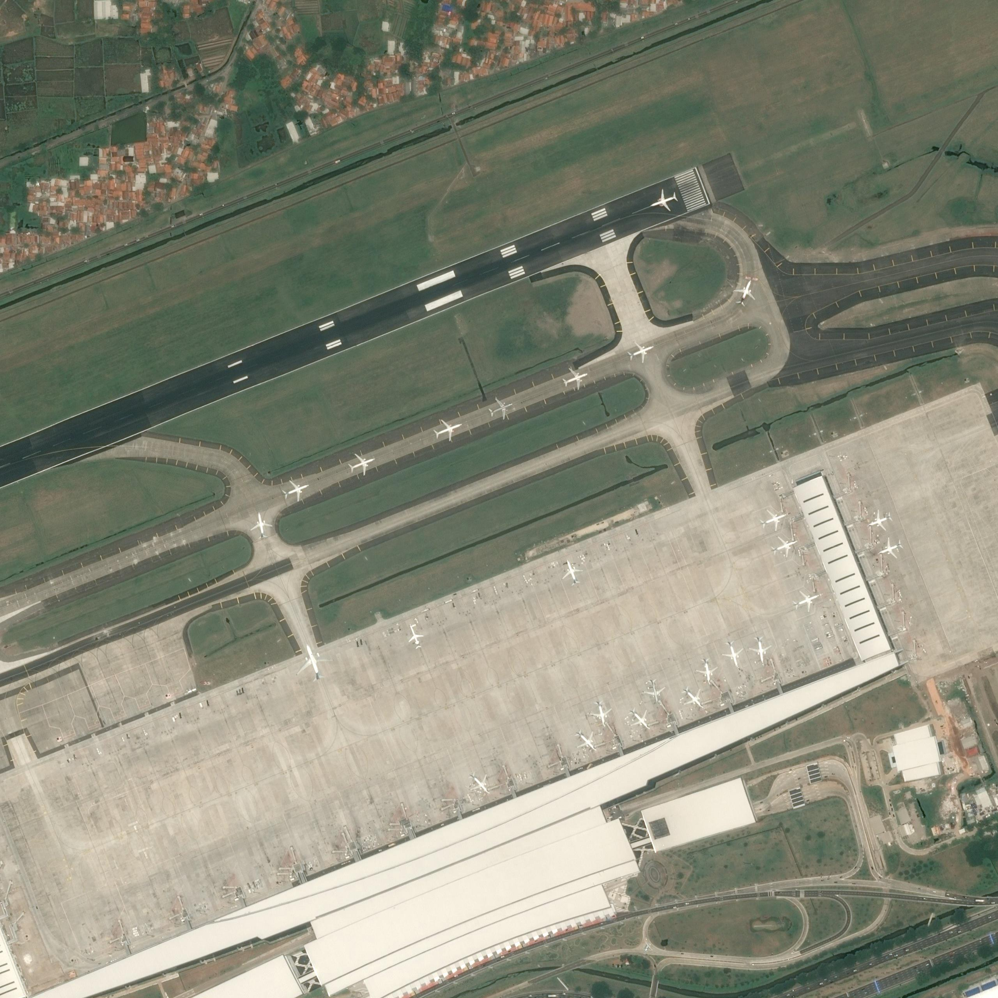
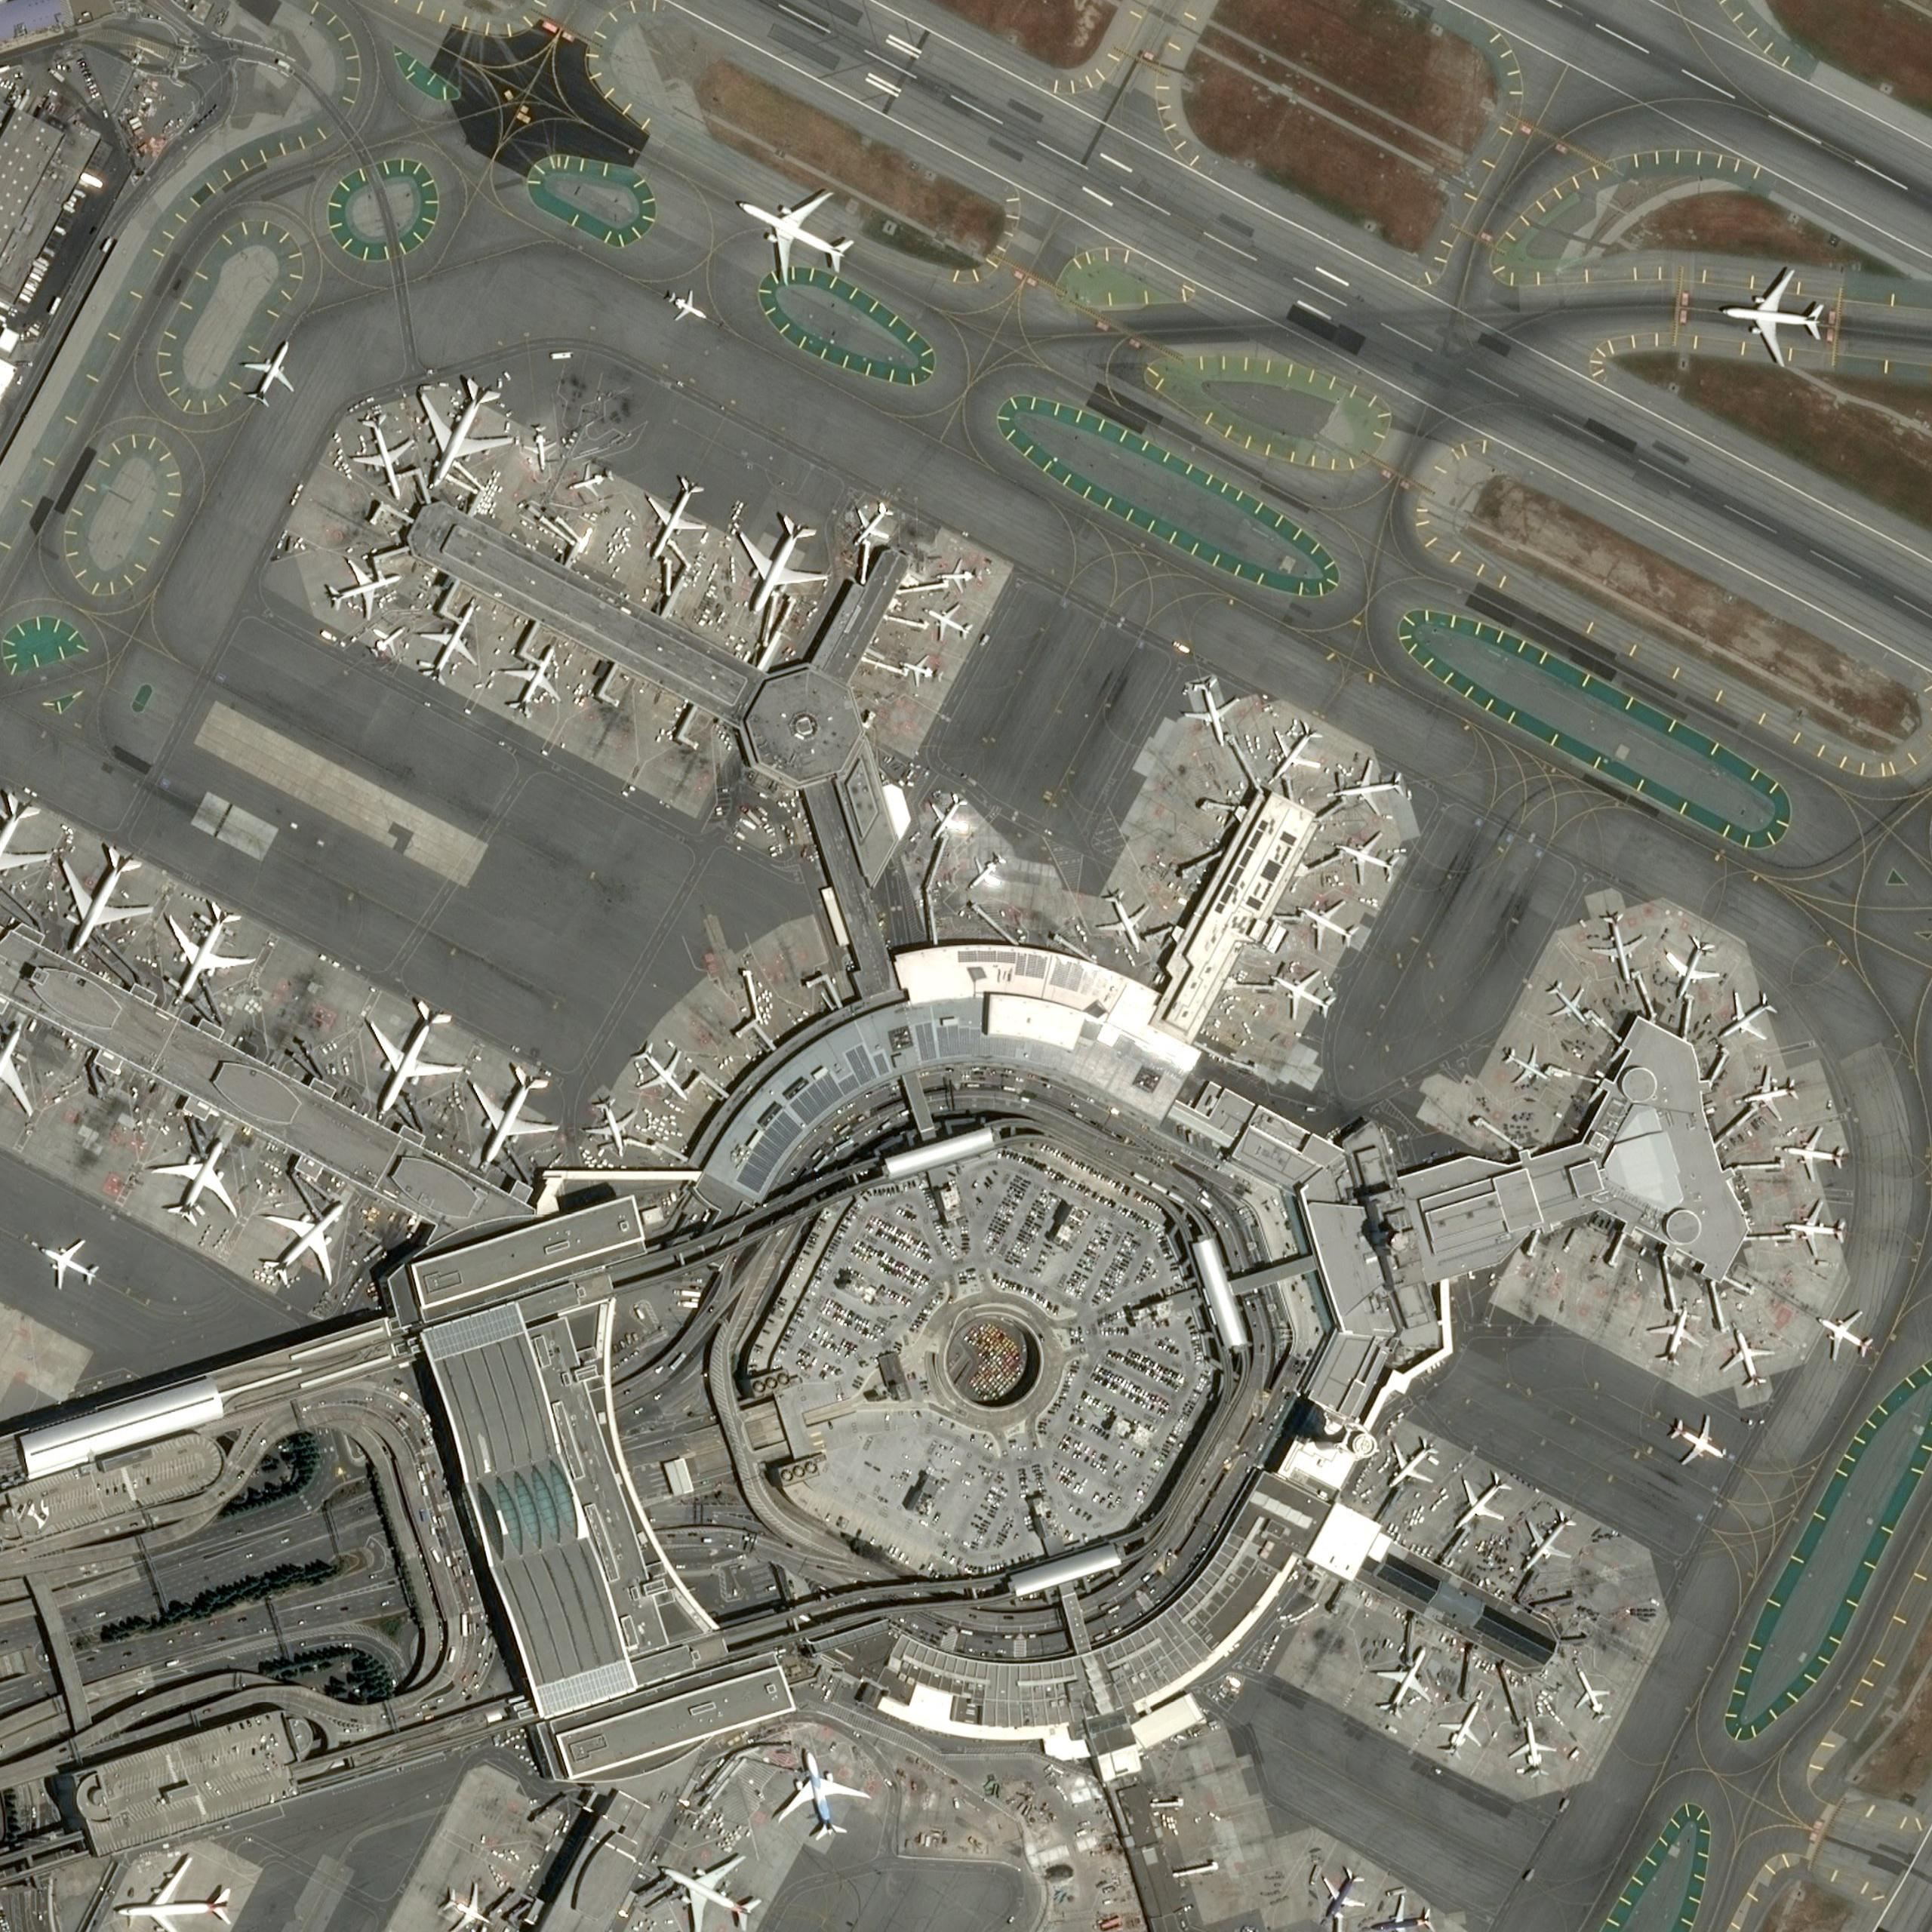
Potential Applications : Aircraft Detection
A potential application of the Traverse-Based Adaptive Clustering method is in aircraft detection within high-resolution remote sensing images.
If successfully implemented with accurate classification, this approach this approach can play a crucial role in identifying and monitoring aircraft across various terrains.
This method might be particularly useful in busy airport settings or areas where aircraft tracking is essential for security and logistical purposes.
With real time remote sensing images, aircraft tracking can improve border surveillance by detecting unauthorized flights and aid disaster response efforts by coordinating relief aircraft and preventing airspace commotion.

Slide 20
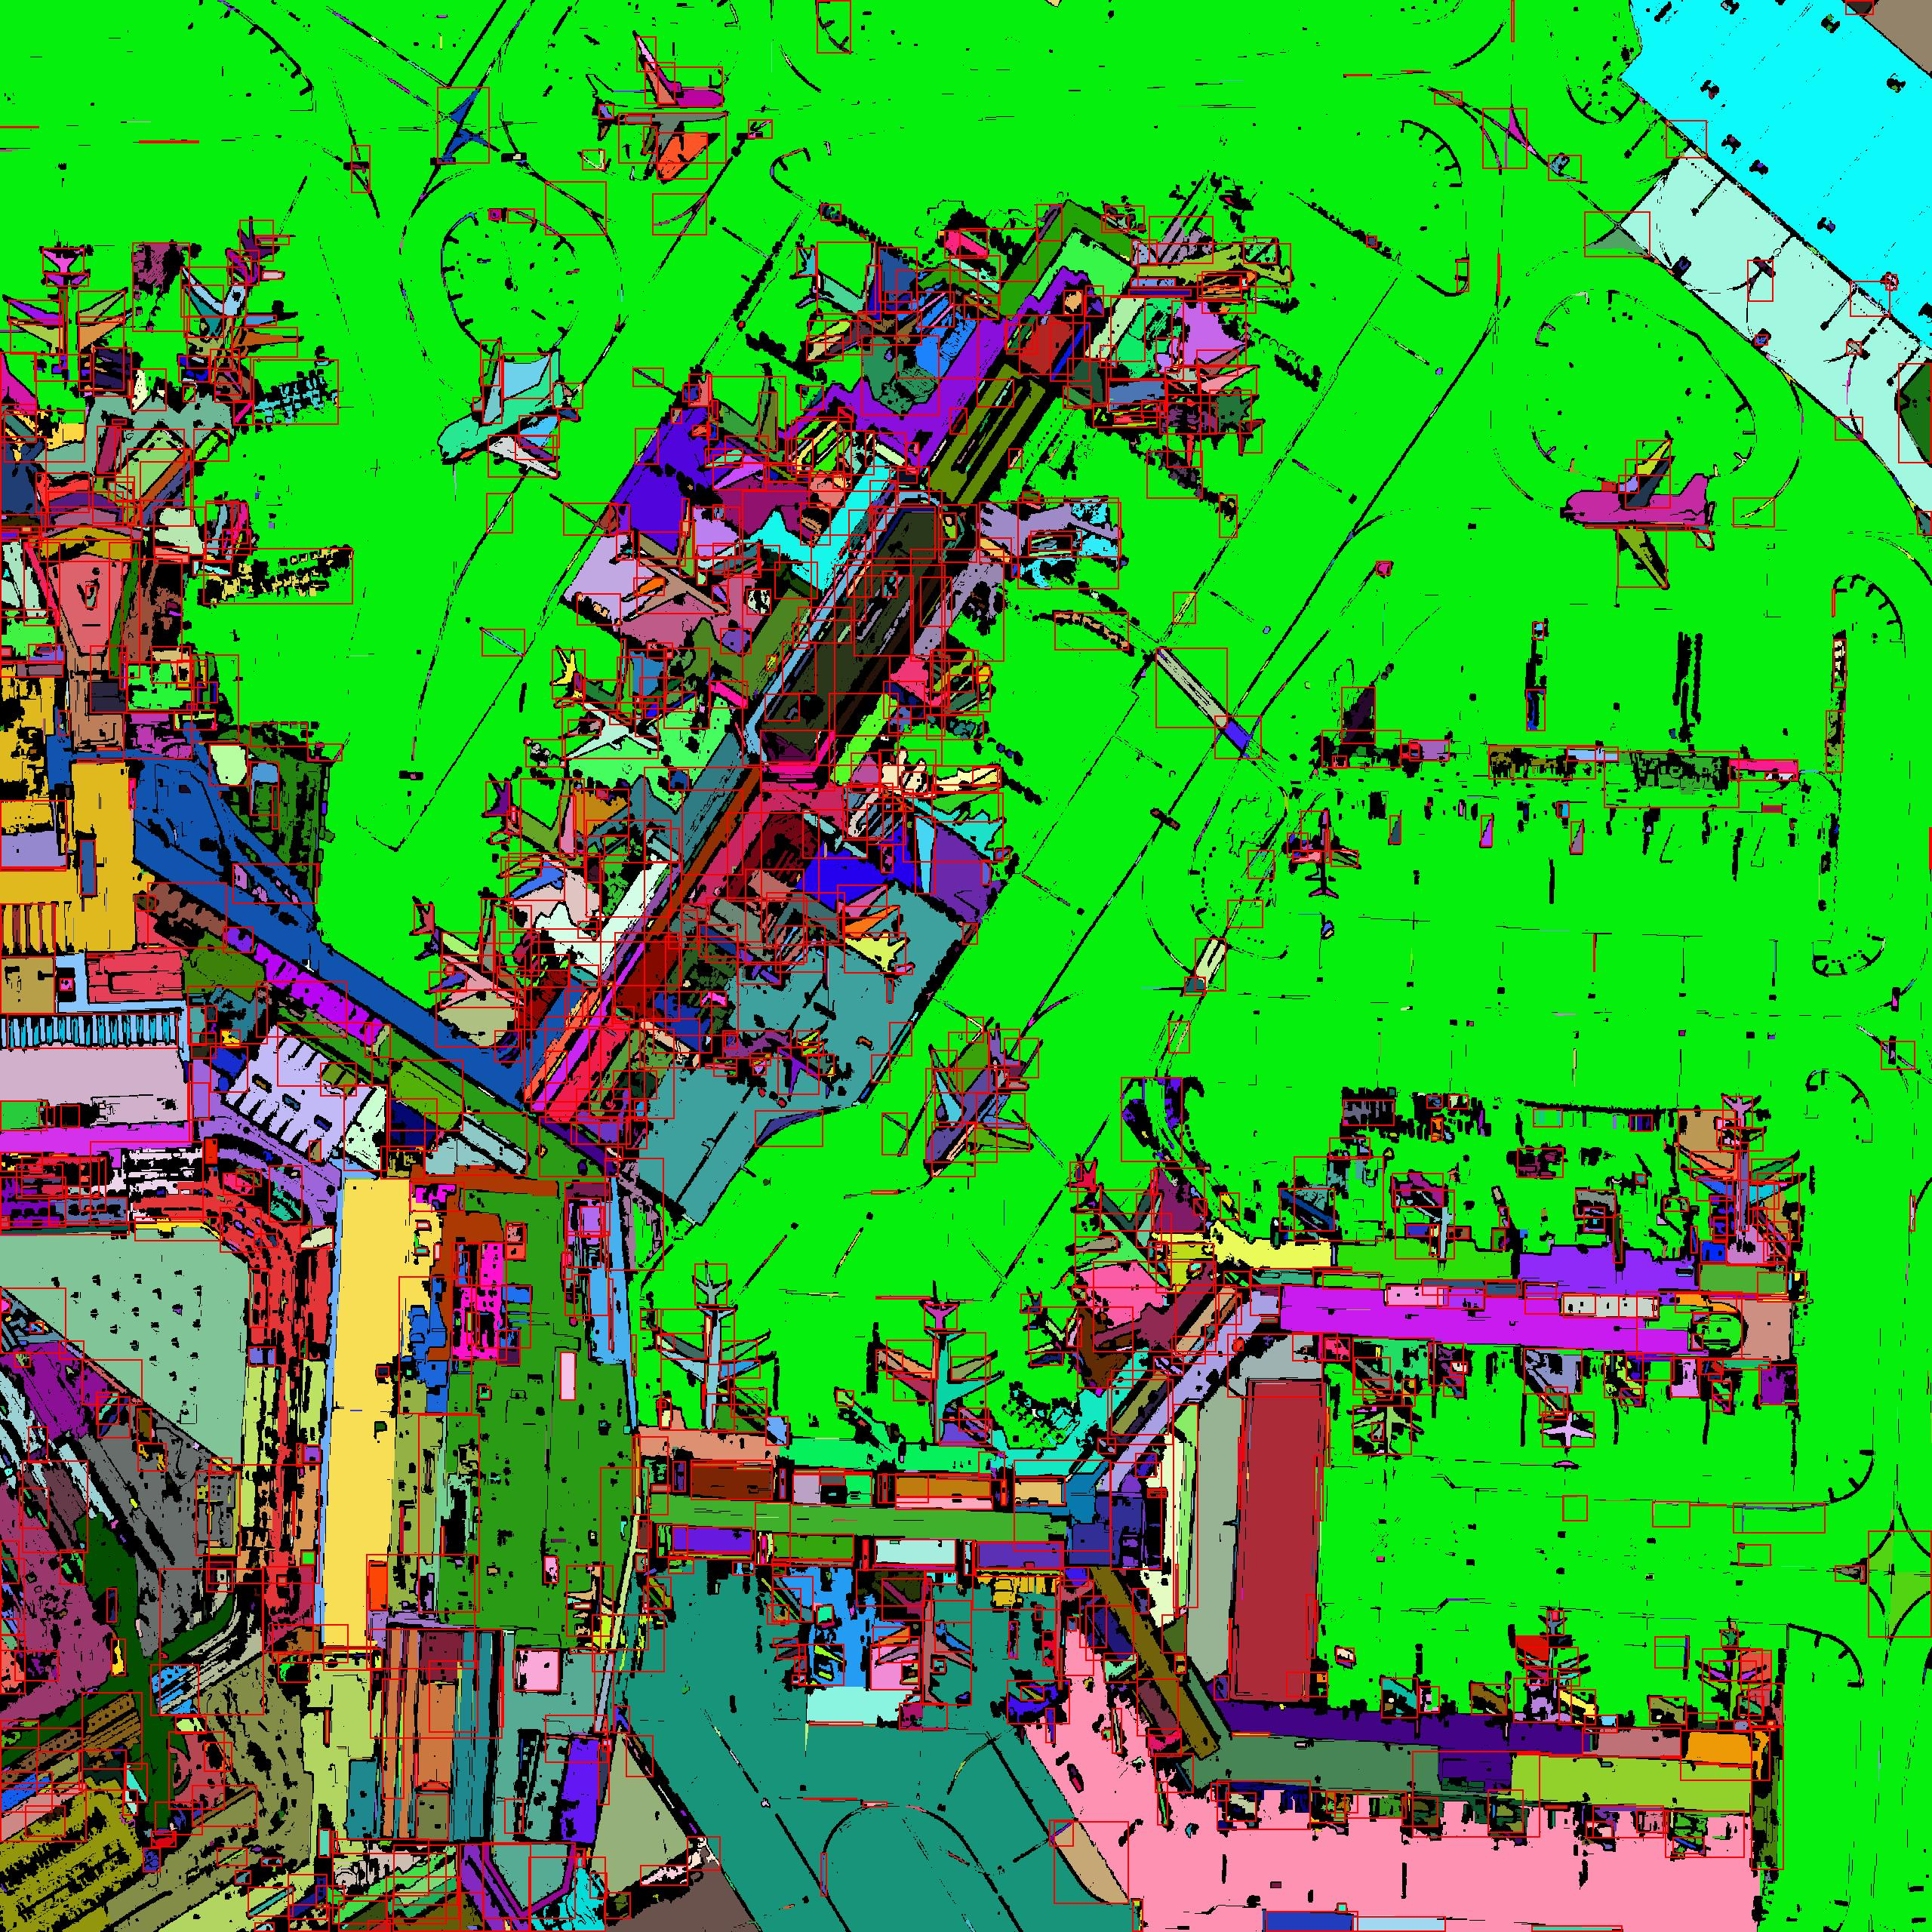
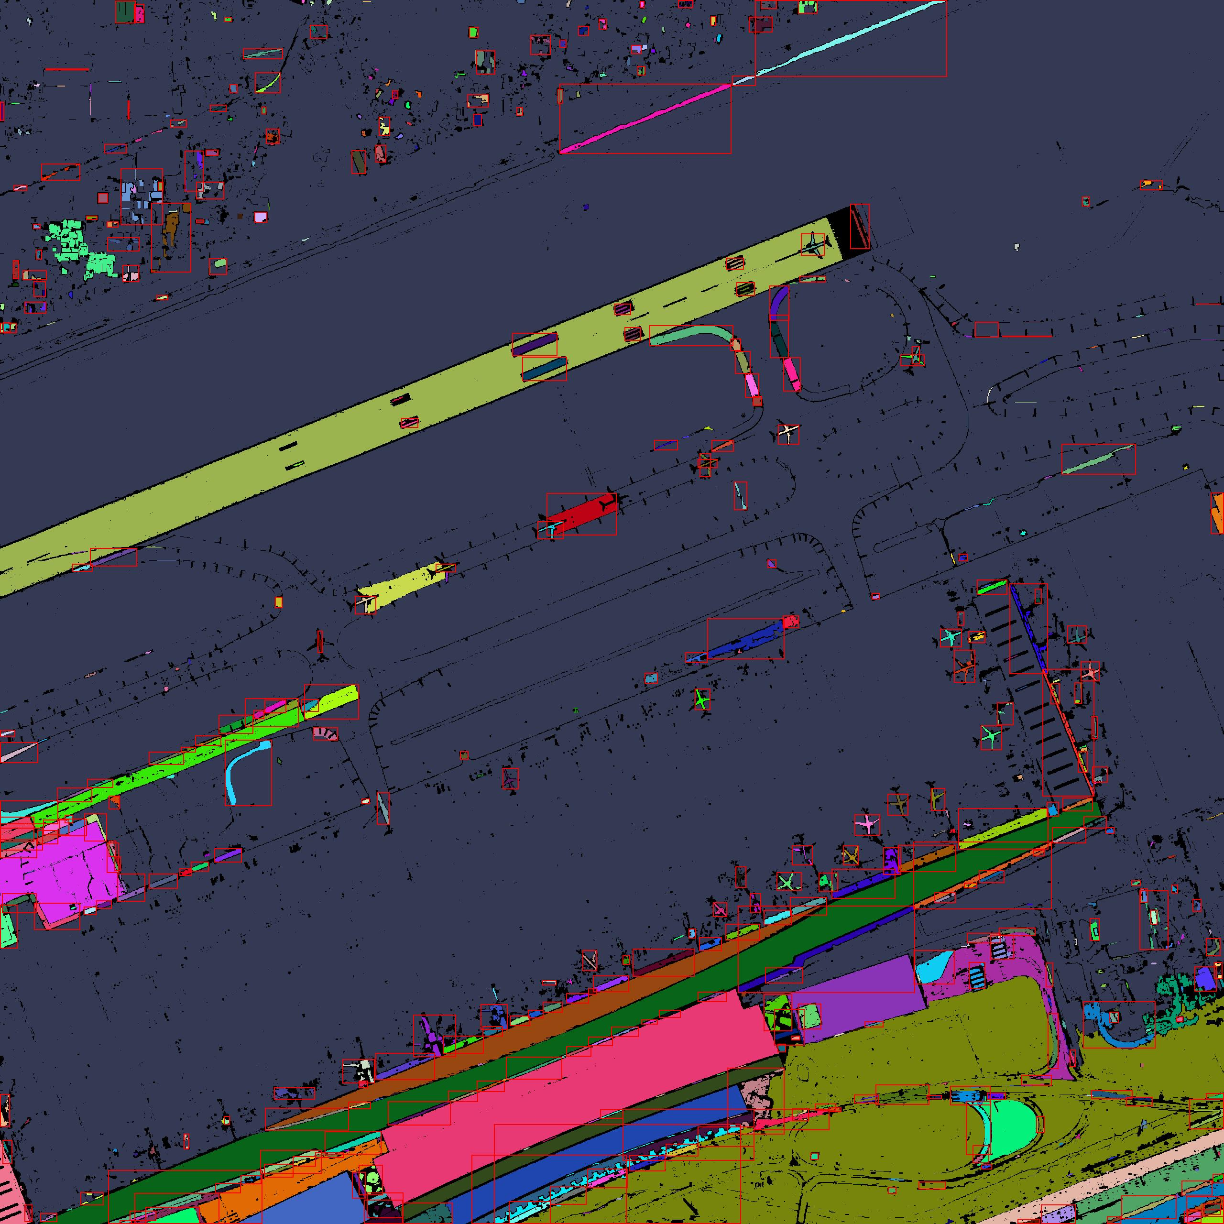
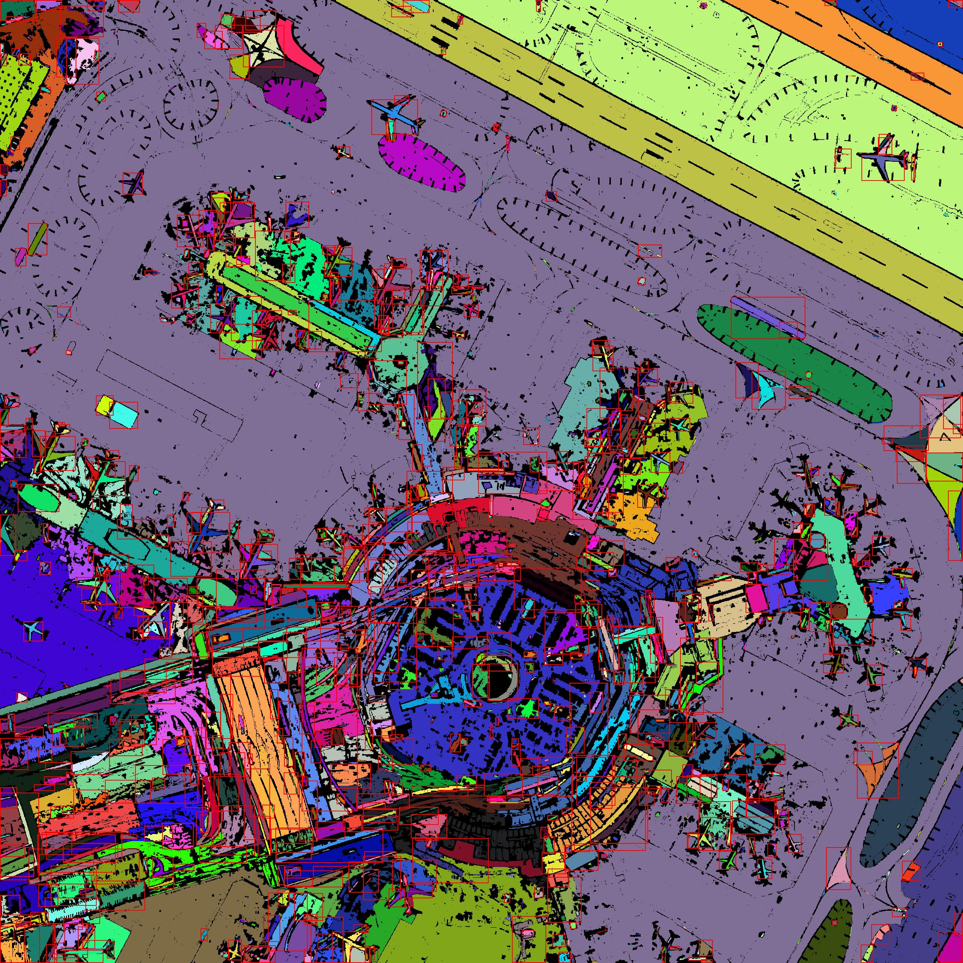
Potential Applications : Aircraft Detection
Effectively detecting the aircraft relies in accurately clustering and segmenting salient regions, such as aircraft bodies from complex backgrounds.
Our algorithm refines clusters with adaptive thresholds for color and spatial proximity , helping distinguish aircrafts from similar-looking objects like buildings and vehicles.
Reliable detection depends on the algorithm’s ability to classify segmented regions accurately, ensuring it correctly identifies aircrafts over other objects.
Using Bounding Boxes around segmented clusters provide clear visualization of detected aircraft, supporting scalable applications like real-time monitoring in high-traffic areas.
This method will be especially beneficial for large-scale airport-management and scenarios where rapid response to unauthorized aircraft is critical.

Slide 21
References
Achanta, R., Shaji, A., Smith, K., Lucchi, A., Fua, P., & Süsstrunk, S. (2012). SLIC Superpixels Compared to State-of-the-Art Superpixel Methods. IEEE Transactions on Pattern Analysis and Machine Intelligence, 34(11), 2274–2282. https://doi.org/10.1109/TPAMI.2012.120
Comaniciu, D., & Meer, P. (2002). Mean shift: A robust approach toward feature space analysis. IEEE Transactions on Pattern Analysis and Machine Intelligence, 24(5), 603–619. https://doi.org/10.1109/34.1000236
Ding, L., Wang, X., & Li, D. (2022). Visual Saliency Detection in High-Resolution Remote Sensing Images Using Object-Oriented Random Walk Model. IEEE Journal of Selected Topics in Applied Earth Observations and Remote Sensing, 15, 4698–4707. https://doi.org/10.1109/JSTARS.2022.3179461
Felzenszwalb, P. F., & Huttenlocher, D. P. (2004). Efficient Graph-Based Image Segmentation. International Journal of Computer Vision, 59(2), 167–181. https://doi.org/10.1023/B:VISI.0000022288.19776.77
Hu, G., Yang, Z., Han, J., Huang, L., Gong, J., & Xiong, N. (2018). Aircraft detection in remote sensing images based on saliency and convolution neural network. EURASIP Journal on Wireless Communications and Networking, 2018(1), 26. https://doi.org/10.1186/s13638-018-1022-8
Kumar, J. M. (2020). Image Segmentation using K-means Clustering. International Journal of Advanced Science and Technology, 29(6).
Li, W., & Pan, C. (2011). Saliency-Based Automatic Target Detection in Remote Sensing Images. In G. Shen & X. Huang (Eds.), Advanced Research on Computer Science and Information Engineering (Vol. 153, pp. 327–333). Springer Berlin Heidelberg. https://doi.org/10.1007/978-3-642-21411-0_53
Liu, B., Zhao, L., Li, J., Zhao, H., Liu, W., Li, Y., Wang, Y., Chen, H., & Cao, W. (2021). Saliency-Guided Remote Sensing Image Super-Resolution. Remote Sensing, 13(24), 5144. https://doi.org/10.3390/rs13245144
Vedaldi, A., & Soatto, S. (2008). Quick Shift and Kernel Methods for Mode Seeking. In D. Forsyth, P. Torr, & A. Zisserman (Eds.), Computer Vision – ECCV 2008 (Vol. 5305, pp. 705–718). Springer Berlin Heidelberg. https://doi.org/10.1007/978-3-540-88693-8_52
Wang, X., Lv, Q., Wang, B., & Zhang, L. (2013). Airport detection in remote sensing images: A method based on saliency map. Cognitive Neurodynamics, 7(2), 143–154. https://doi.org/10.1007/s11571-012-9223-z
Yang, S., & Zhao, X. (2018). Remote Sensing Image Change Saliency Detection Technology. Journal of Physics: Conference Series, 1069, 012110. https://doi.org/10.1088/1742-6596/1069/1/012110
Zhao, D., Wang, J., Shi, J., & Jiang, Z. (2015). Sparsity-guided saliency detection for remote sensing images. Journal of Applied Remote Sensing, 9(1), 095055. https://doi.org/10.1117/1.JRS.9.095055
Zhou, H., Wang, X., & Schaefer, G. (2011). Mean Shift and Its Application in Image Segmentation. In H. Kwaśnicka & L. C. Jain (Eds.), Innovations in Intelligent Image Analysis (Vol. 339, pp. 291–312). Springer Berlin Heidelberg. https://doi.org/10.1007/978-3-642-17934-1_13

Slide 22
Thank
You!

